Slide 1
Detecting Malicious Blockchain Activity
Presenters: Ori Sinvani, Nehoray Chalfon, Harel Brener Project Advisor: Ofer Zevin Data science Project

Slide 2
Background
Crypto
Problem
Solution
Blockchain technology caused a financial revolution
Instant transfer
Unregulated
Anonymous
Today the technology is used in part for:
Money laundering
Terror funding
Tax evasion
There is a need for automatic tools to track these behaviours
Notes:
הבלוקצ'יין הוא ספר חשבונות דיגיטלי מבוזר שמתעד עסקאות על פני רשת מחשבים, בצורה שקופה ושאינה ניתנת לשינוי. במקום להסתמך על גורם מרכזי כמו בנק, הרשת כולה מאמתת ומאבטחת כל עסקה.

Slide 3
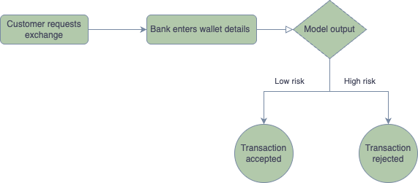
Our Clients
Our product is made for:
Financial institutions
Military and police
Businesses and individuals

Slide 4
Goals & Challenges

Slide 5
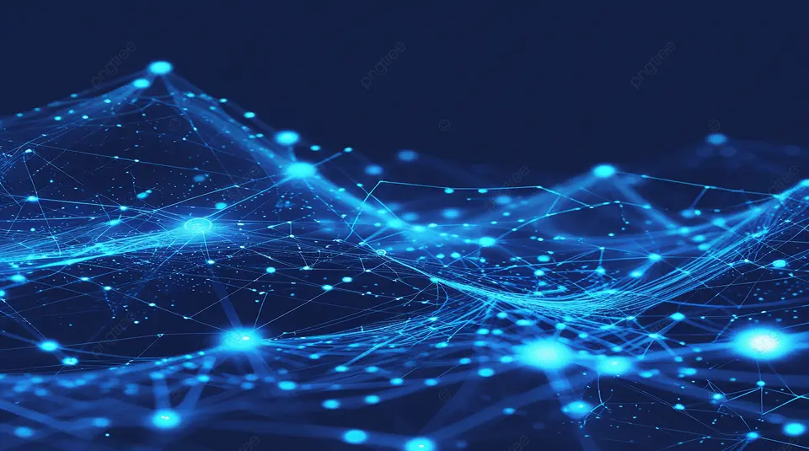
Goals
Build a system that:
Interaction with user
Processes real-time transaction data
Classification of requested wallet
Results Showcase to user

Slide 6

The Core Challenge
Anonymity in practice
Massive transaction volume
Complex Network
Therefore, the solution must include:
Business-logic transaction analysis
Building a transaction-graph model (GNN)

Slide 7
System Architecture

Slide 8
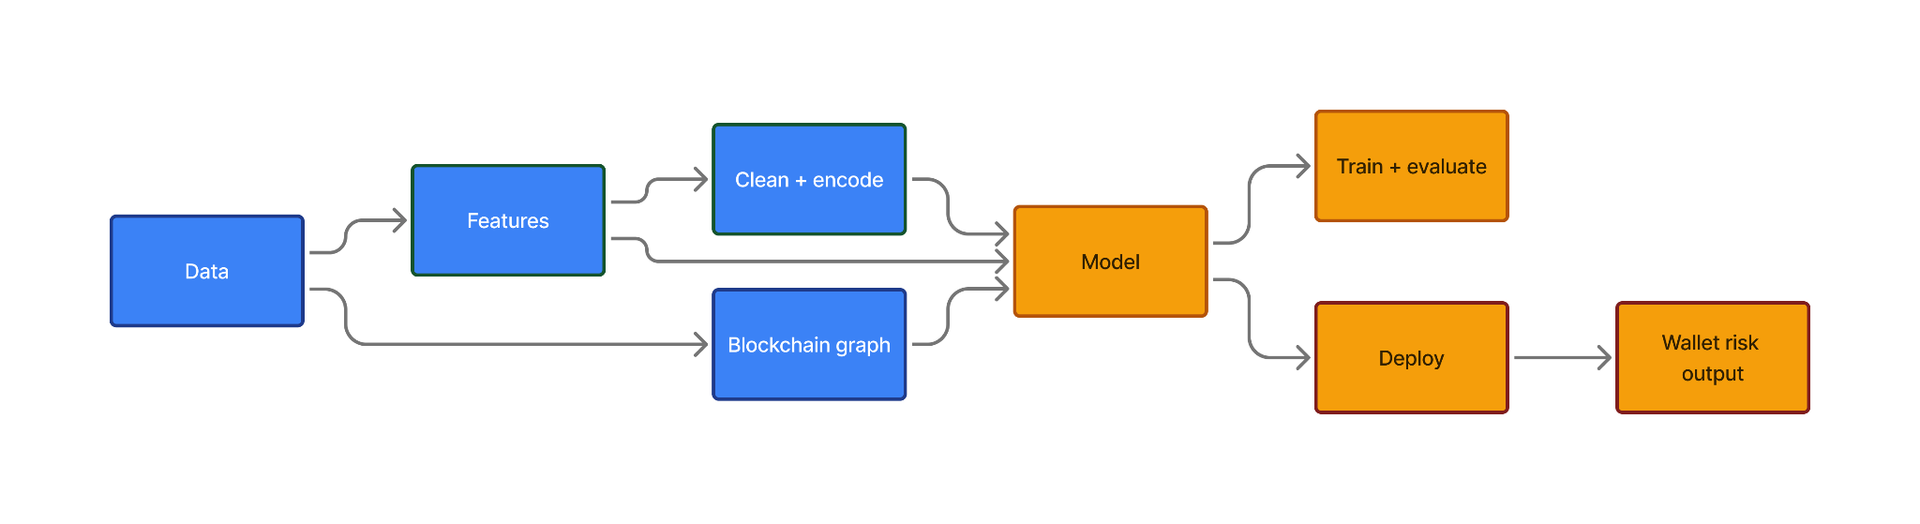
WorkFlow Pipeline

Slide 9

Data
Elliptic++
Bitcoin, 203K labeled transactions
Anonymized features
Real-CATS
Over 200K labeled wallets
Bitcoin & Ethereum
25 Features

Slide 10
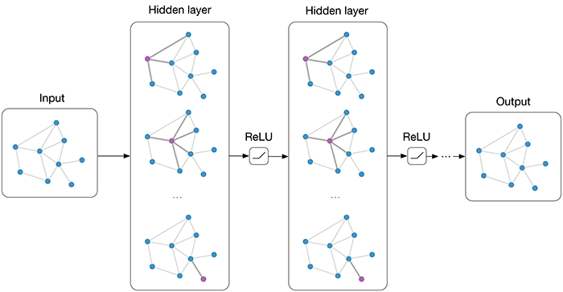
Feature Extraction & model
Numerical features:
Node degrees
Transaction Counts
Graph features:
Pagerank
Clustering
Deep learning models
GCN
GraphSAGE

Slide 11
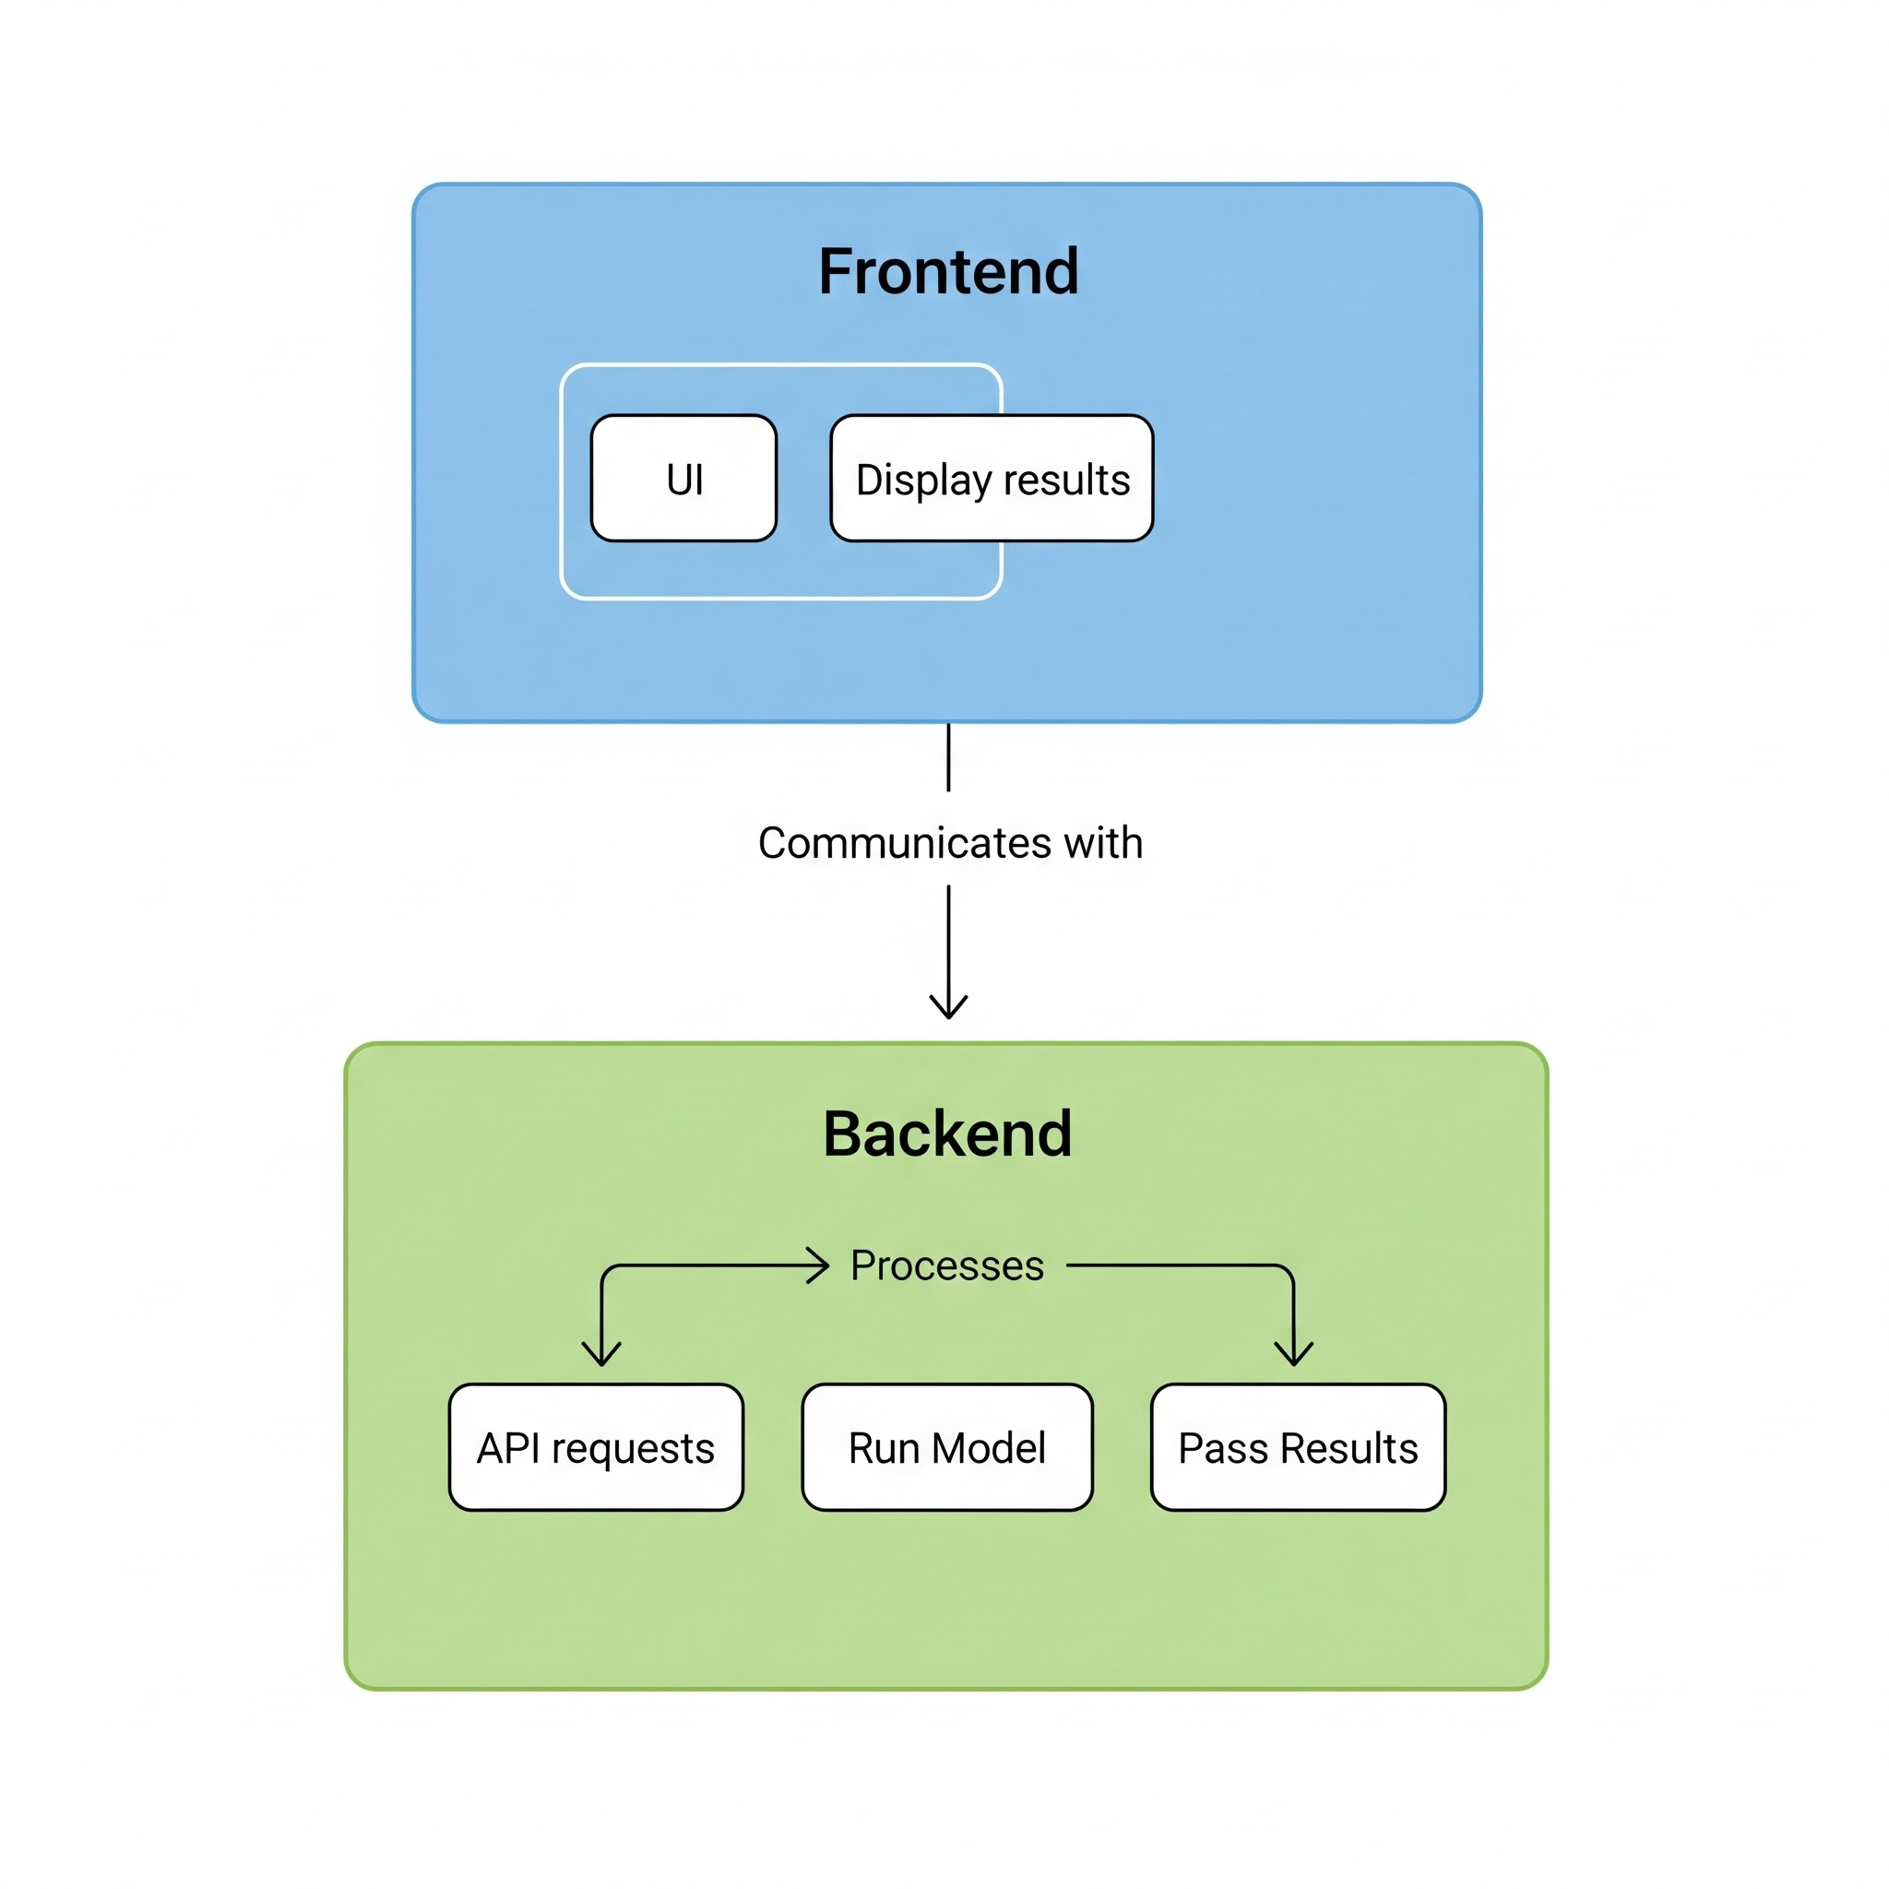
Fullstack
Frontend
UI
Display results
Backend
API requests
Run Model
Pass Results

Slide 12
Timeline & Risks

Slide 13
Timeline
Main idea
Initial presentation
Prototype website with risk analysis
Decently trained model
First website version
Initial graph training
21.11.25
11.12.25
27.12.25
3.1.26
16.01.26
Literature review
Feasibility analysis
Baseline model evaluation
Training a more advanced model
Connecting the model to the website

Slide 14

Potential Risks and Problems
class imbalance
Oversampling
Precision@k-based evaluation
Massive graphs
Mini-batch neighborhood sampling
Label noise
Combine unsupervised methods + anomaly-detection signals

